Slide 1


MULTIMODAL FAKE
NEWS DETECTION SYSTEM
by-
Manan Goel E23CSEU0475 Vibhor Agarwal E23CSEU0470

Slide 2



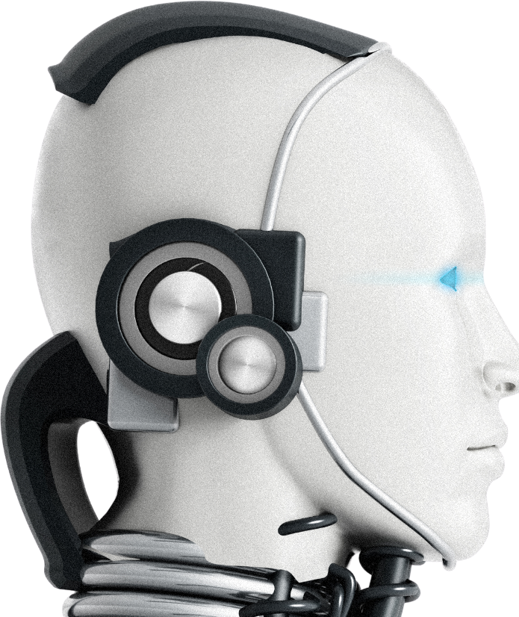
Project Overview
A Multimodal Fake News Detection System aims to identify and combat fake news by analyzing multiple forms of data (e.g., text, images, videos) rather than relying on a single data type. This approach leverages various modalities—like visual, textual, and sometimes even audio data—to enhance the accuracy of detecting misinformation. Below is an overview of the project's components and how they come together.

Slide 3




Problem Statement
The rapid spread of misinformation and fake news on digital platforms—such as social media, blogs, and news websites—poses a significant threat to society. Current fake news detection systems primarily rely on text analysis, which limits their ability to accurately identify misleading content, especially when fake news is paired with deceptive or misleading visuals. Given the increased use of images, videos, and other multimedia formats to convey false information, there is a critical need for a more comprehensive solution that can handle diverse data types.
The core problem is to develop an effective and reliable fake news detection system that can analyze and integrate multiple data modalities—text, images, and potentially videos—to enhance the accuracy and reliability of identifying false information.

Slide 4







Methodology
thynk unlimited
Data Collection
Gather relevant data from diverse sources.
Preprocessing
Clean, normalize, and engineer data.
Model Selection
Choose and train ML/DL algorithms for peak performance.

Slide 5


thynk unlimited
Data Collection and Preprocessing
Text Data: Collect news articles, social media posts,
and user comments from verified sources as well as potential fake news sources.
Visual Data: Gather images associated with the collected news or social media posts. Images can include memes, infographics, photographs, or manipulated visuals.
Video Data (Optional): Capture video clips or frames from multimedia news sources if dealing with video- based misinformation.
Datasets: Use pre-existing multimodal datasets like Weibo, Fakeddit, or BuzzFeedNews for training and testing. Curate custom datasets if specific domains are targeted.
Data Preprocessing Text Preprocessing:
Tokenization: Break down the text into individual tokens (words).
Remove Stop Words: Remove common but irrelevant words (like "and," "the").
Stemming/Lemmatization: Reduce words to their root forms. Text Cleaning: Remove URLs, special characters, and numbers.
Feature Engineering: Create TF-IDF scores, word embeddings (Word2Vec, GloVe), and embeddings from Transformer models (BERT, RoBERTa).
Image Preprocessing:
Resize images to a standard dimension for model compatibility.
Normalization: Scale pixel values to a common range.
Data Augmentation: Use techniques like rotation, flipping, and cropping to artificially increase the dataset size.
Feature Extraction: Use pre-trained CNN models (like VGG16, ResNet, or InceptionNet) to extract visual features.
Video Preprocessing (Optional):
Extract frames from video clips at regular intervals.
Process frames as images for visual analysis.
Use audio-to-text tools to generate transcripts from video for textual analysis.

Slide 6







thynk unlimited
Model Development
The development of a multimodal fake news detection system involves integrating both text and image analysis to improve the accuracy of misinformation identification. Text data is preprocessed using techniques like tokenization, normalization, and word embeddings (e.g., BERT), while visual data is processed using CNNs (e.g., ResNet or VGG) to extract features. These features are combined using data fusion methods, such as early fusion (concatenating features before training) or late fusion (merging predictions from separate models). Multimodal deep learning models, including neural networks with attention mechanisms or transformer-based architectures like VisualBERT, are trained to classify content as fake or real. Evaluation metrics like Accuracy, Precision, and Recall are used to optimize performance, while explainability tools (e.g., SHAP or LIME) provide transparency into model decisions. Finally, the system is deployed using cloud platforms and APIs, enabling real-time analysis and scalability
www.reallygreatsite.com

Slide 7



Evaluation Metrics
To evaluate a multimodal fake news detection system, key metrics include Accuracy, which measures the proportion of correct predictions, and Precision, indicating the percentage of predicted fake news that is truly fake. Recall (sensitivity) assesses how well the model identifies actual fake news, while the F1-Score balances Precision and Recall. ROC- AUCevaluates the model's classification performance across thresholds, and the Confusion Matrix provides a breakdown of prediction outcomes (true/false positives/negatives). Additional metrics like Specificity (true news detection), Log- Loss(prediction uncertainty), and Mean Average Precision (mAP) for image analysis can be used depending on the task, offering a comprehensive view of model effectiveness.

Slide 8




Result and Impact
The implementation of a multimodal fake news detection system can significantly enhance the accuracy and reliability of identifying misinformation. By combining both textual and visual analysis, the system leverages the strengths of each modality, achieving higher precision and recall compared to single-modality approaches. The result is a more nuanced understanding of content, reducing false positives (incorrectly labeling real news as fake) and false negatives (missing actual fake news). This improved detection capability can aid social media platforms, news agencies, and policymakers in mitigating the spread of misinformation, fostering a more informed public discourse. Additionally, the system’s transparency through explainability tools builds user trust by offering insights into why specific content was flagged, encouraging accountability in content sharing. The impact extends to reducing the influence of fake news on public opinion, enhancing digital literacy, and promoting healthier online communities.
4o

Slide 9


Future Directions
Future development of multimodal fake news detection systems will focus on enhancing accuracy, scalability, and adaptability to new misinformation tactics. Integrating advanced multimodal transformers and more sophisticated attention mechanisms can improve the alignment between textual and visual data, allowing for deeper context understanding. Exploring additional data types, such as audio and video, will provide richer multimodal analysis, capturing misinformation in complex multimedia formats.
Another direction is to incorporate real-time detection capabilities, enabling immediate identification and response to fake news on social platforms. There’s also potential in developing more explainable AI tools to increase transparency, making model decisions clearer to users and fostering greater trust. Continuous updates to training datasets to include emerging fake news patterns and improving robustness against adversarial attacks will be crucial. Lastly, collaboration with fact-checking organizations and implementing user feedback mechanisms can help fine-tune the system, creating a dynamic model that evolves with the changing landscape of digital misinformation.

Slide 10
thynk unlimited
Thank You!

